Slide 1
Viruses: Cassava Brown Streak Virus (Potyvirus) and Cassava Mosaic Virus (Geminivirus)

Slide 2
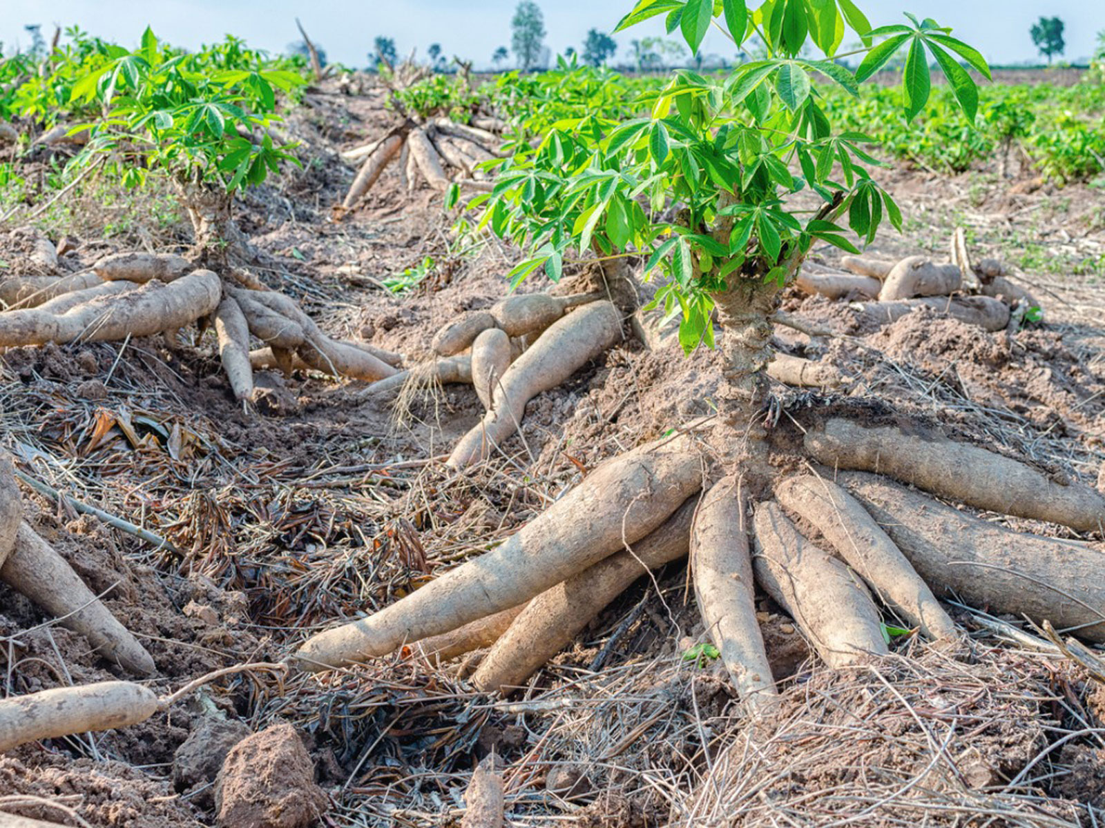
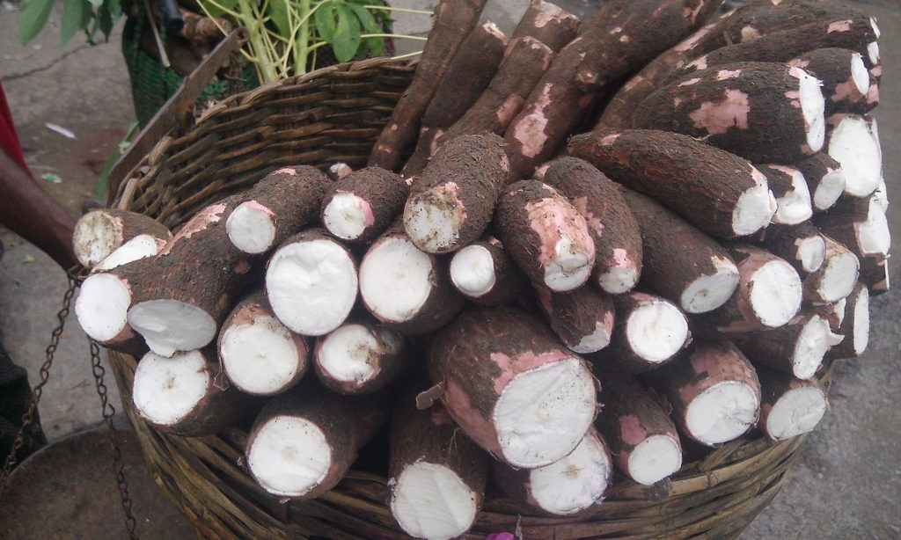
Cassava aka Yuca/Manioc
Notes:
Nigeria is the high yielding country in West Africa

Slide 3
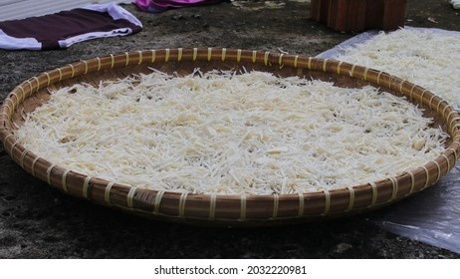



Cassava aka Yuca/Manioc
Notes:
Nigeria is the high yielding country in West Africa

Slide 4
Plant Virology via Two Cassava Viruses:
Cassava Mosaic Virus (CMV)
Cassava Brown Streak Virus (CBSV)
Virology 101
How viruses replicate
How viruses move systemically
Host defenses against viruses
How viruses transmit

Slide 5
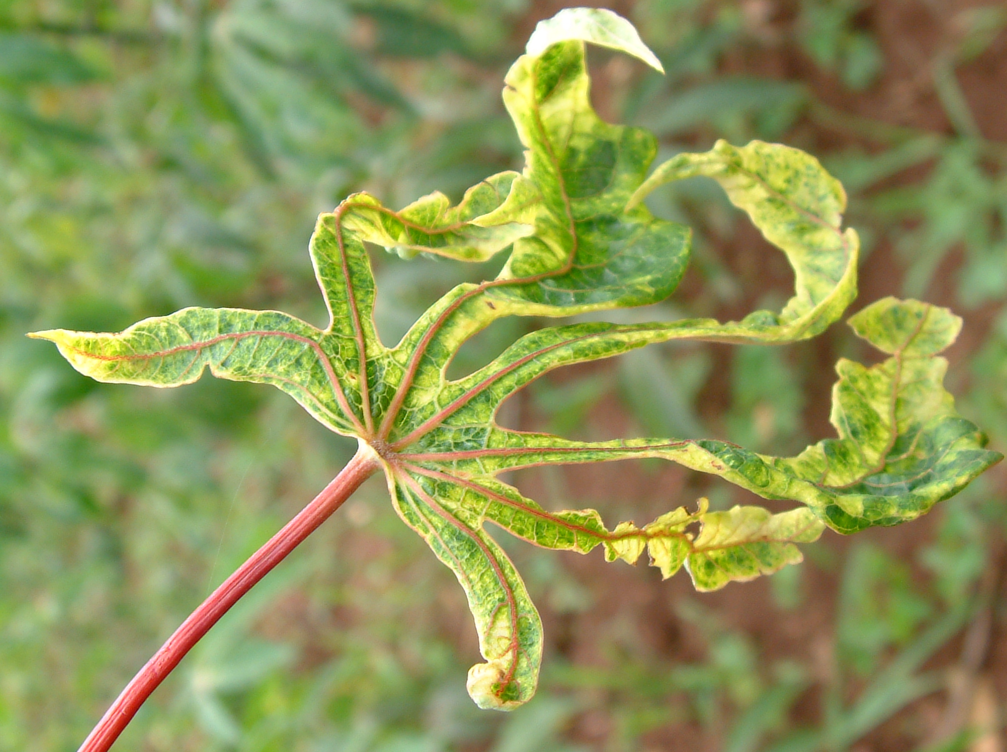
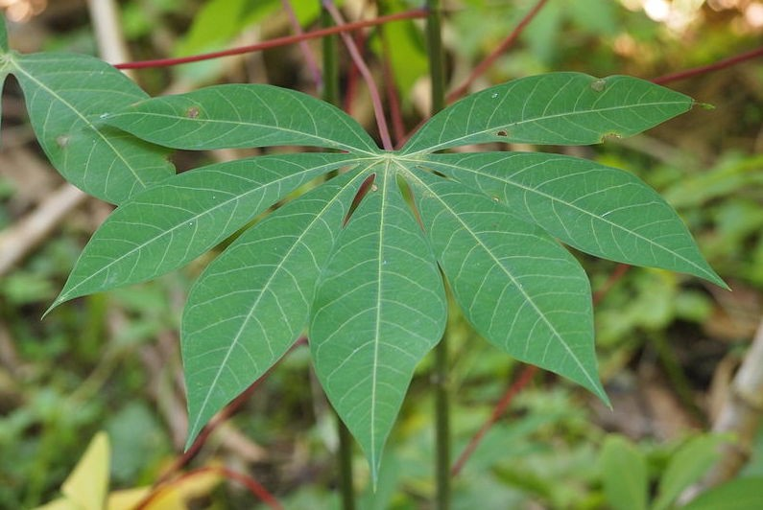
Notes:
Apparently there is a related “Uganda CBSV” UCBSV.

Slide 6
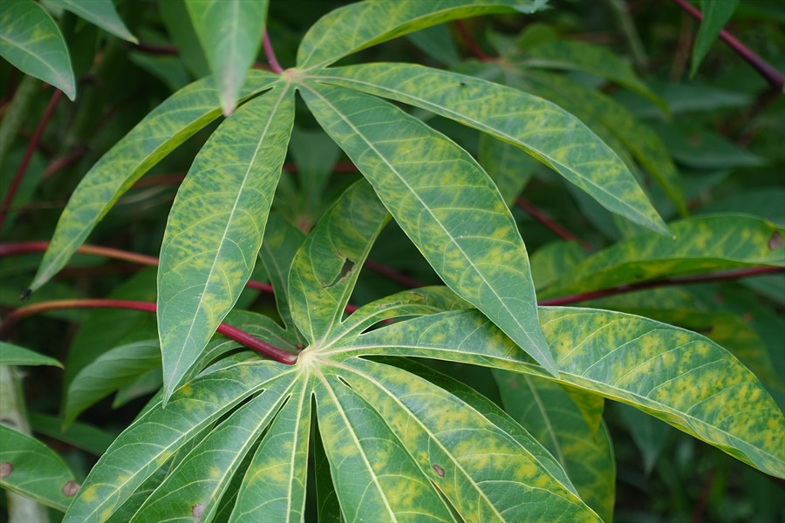
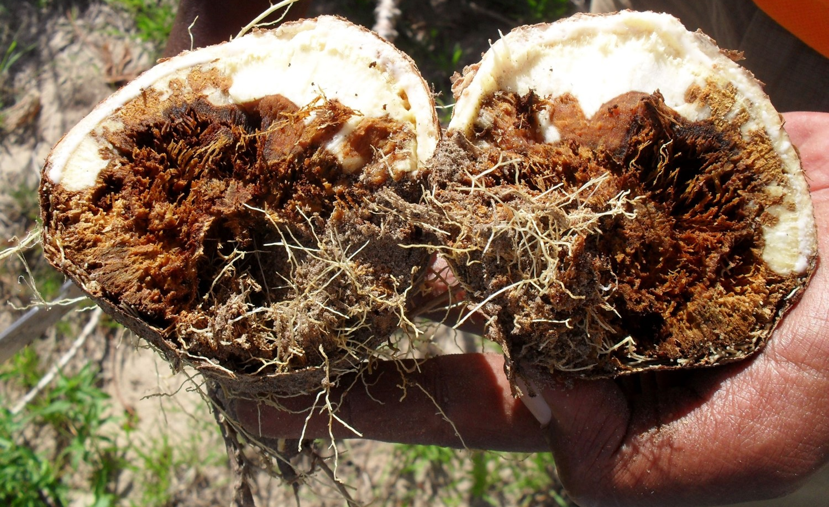
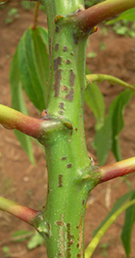
Notes:
Apparently there is a related “Uganda CBSV” UCBSV.

Slide 7
CMV: Cassava Mosaic Virus
CBSV: Cassava Brown Streak Virus
Family
Genome
Shape
Genome size

Slide 8
Genome organization & Replication: Geminiviruses (ssDNA)

Slide 9
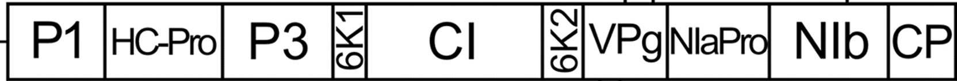
Genome organization/expression: Potyviruses ssRNA(+)

Slide 10
Genome replication: Potyviruses ssRNA(+)

Slide 11

Cell-Cell Movement:

Slide 12
Systemic Movement

Slide 13
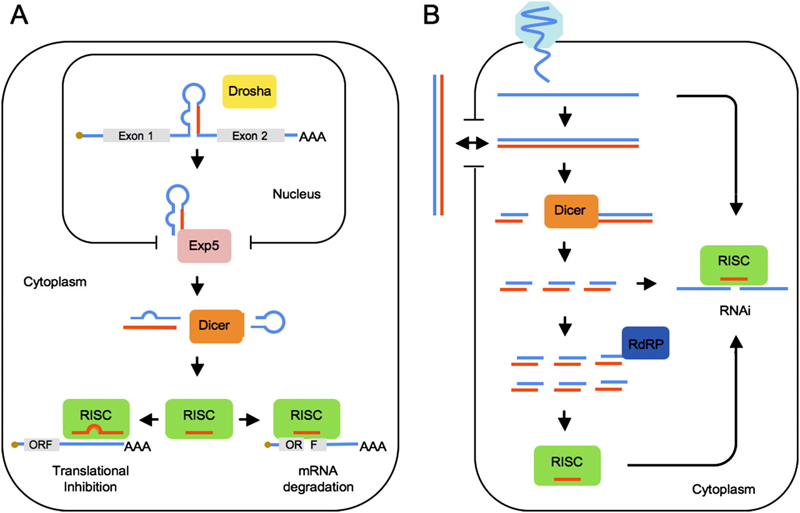
Plant defense: RNA interference

Slide 14


Viral-counter-defense

Slide 15
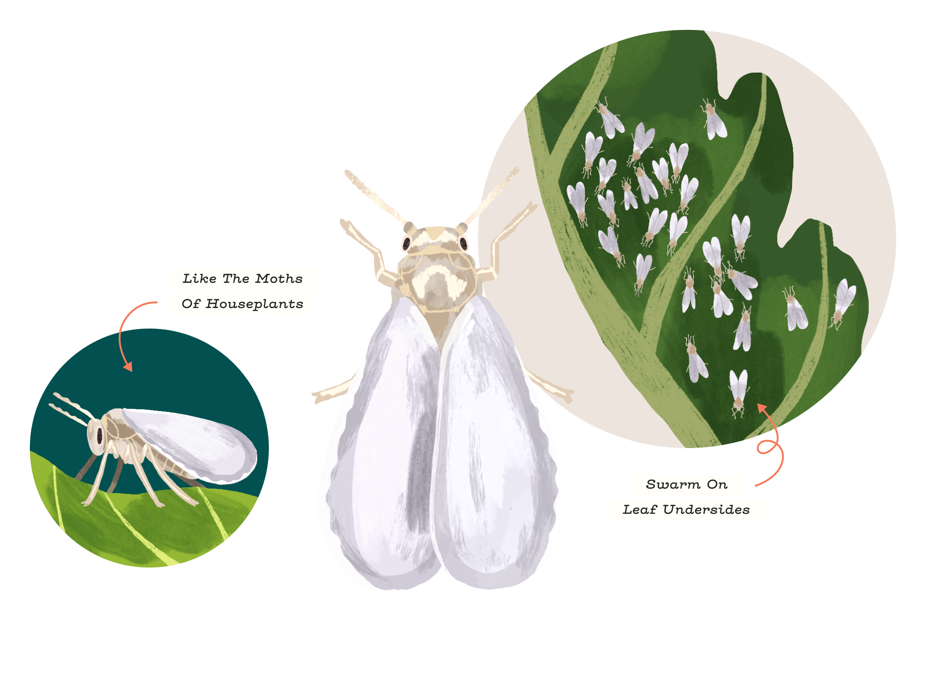
Ecology: Transmission
CMV
CBSV
Notes:
Apparently there is a related “Uganda CBSV” UCBSV.

Slide 16
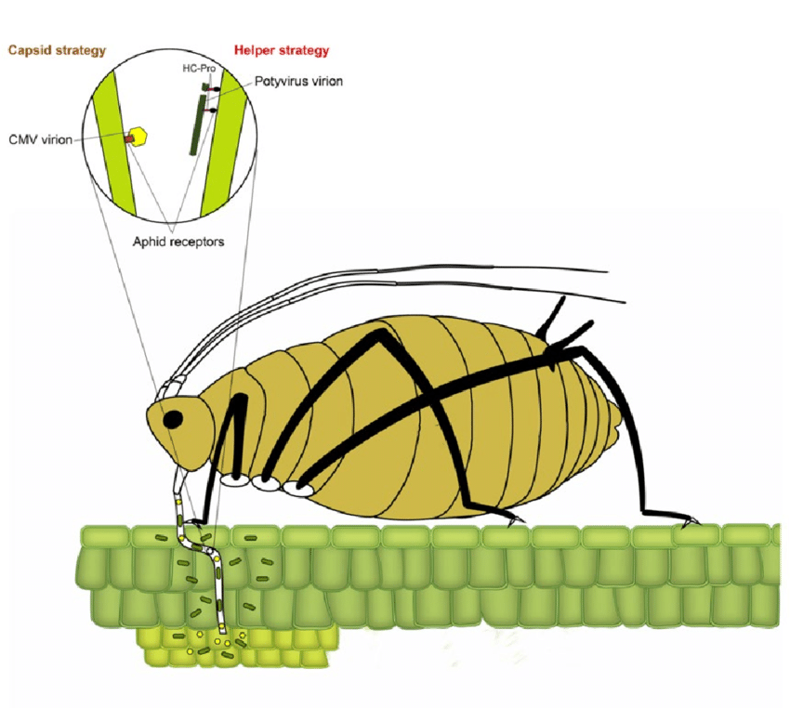
Non-persistent Insect-vectored pathogens (CMV)
Notes:
Apparently there is a related “Uganda CBSV” UCBSV.

Slide 17
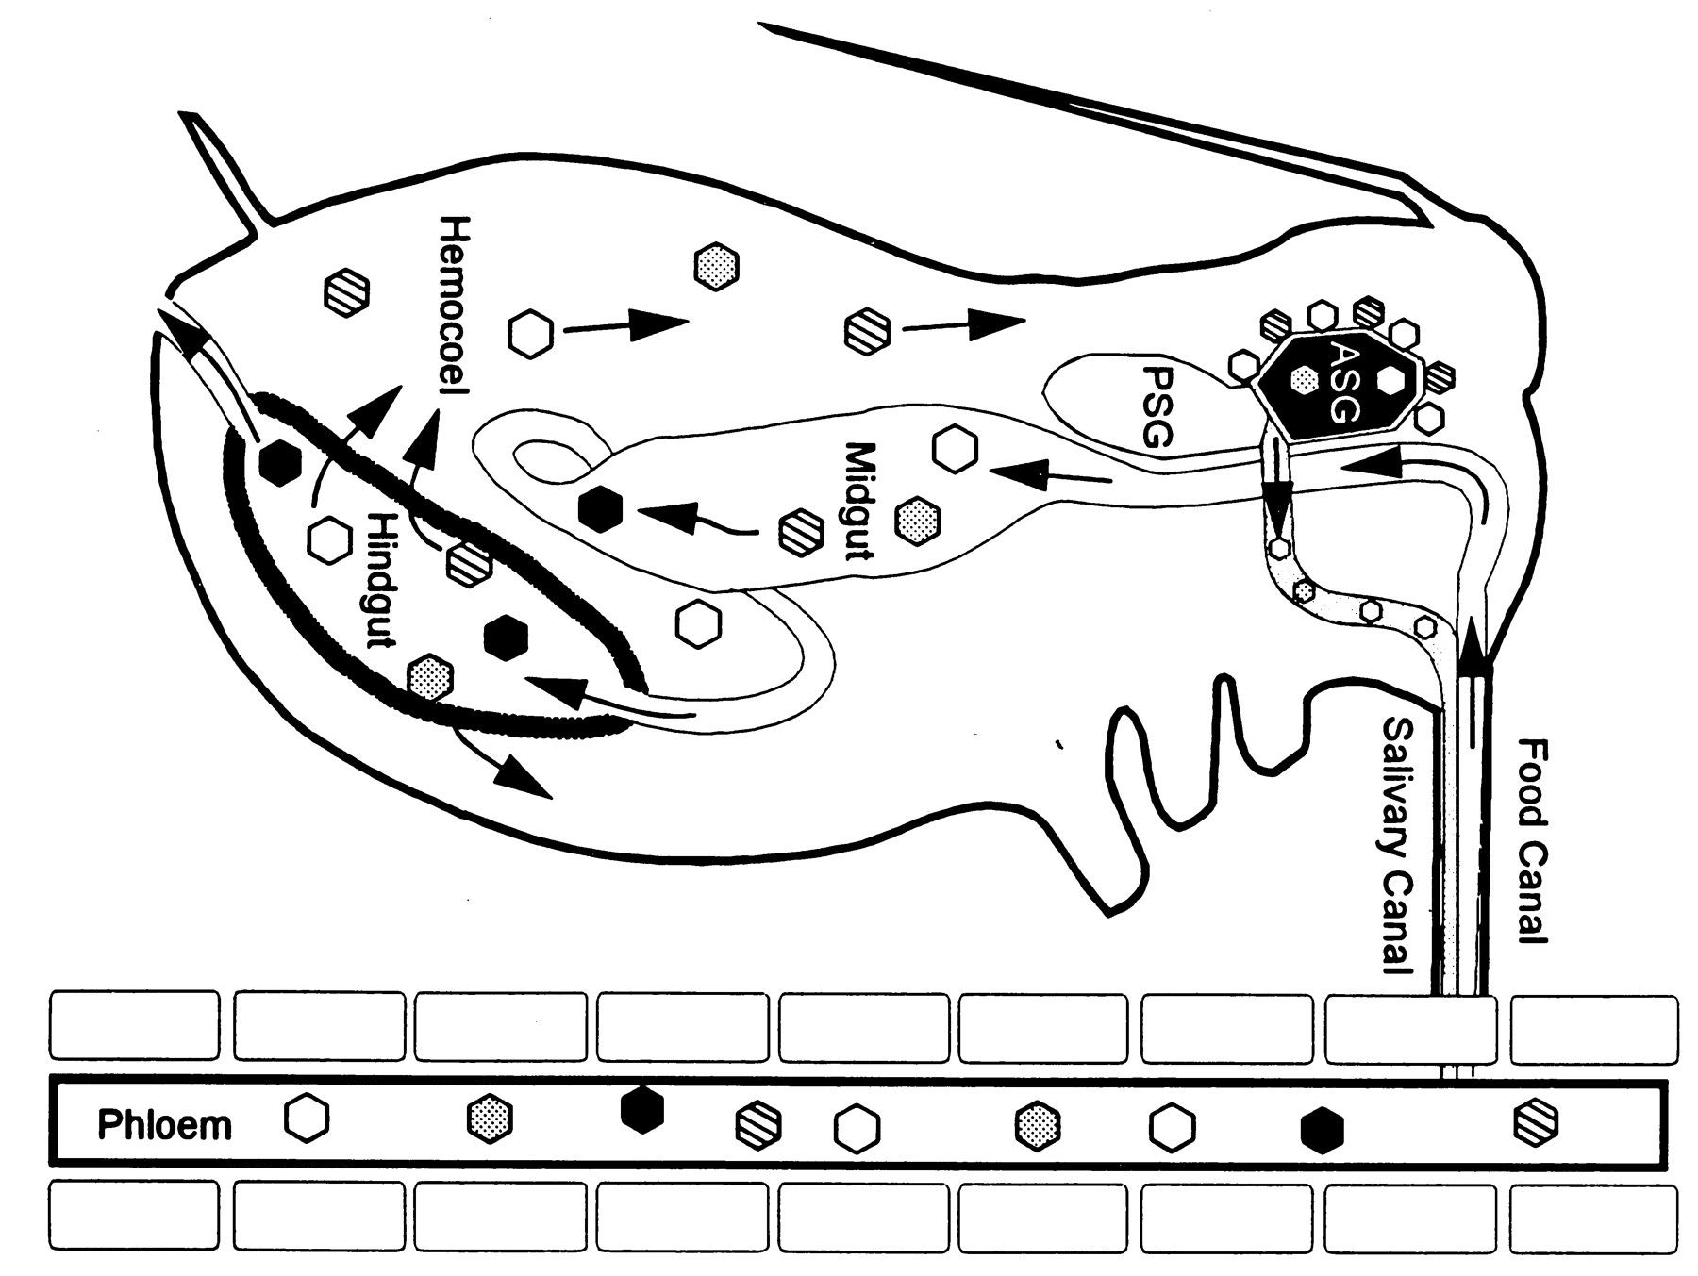
Persistent, circulative Insect-vectored pathogens (CBSV)
Notes:
Apparently there is a related “Uganda CBSV” UCBSV.

Slide 18
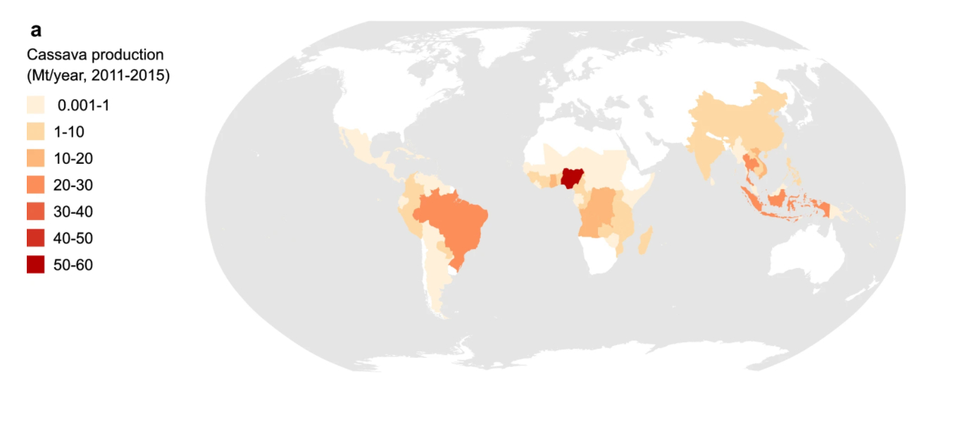
Biogeography of Cassava & High-impact viruses
Cassava Production
Mt=Megaton
Notes:
Nigeria is the high yielding country in West Africa
https://environmentalevidencejournal.biomedcentral.com/articles/10.1186/s13750-018-0142-2

Slide 19
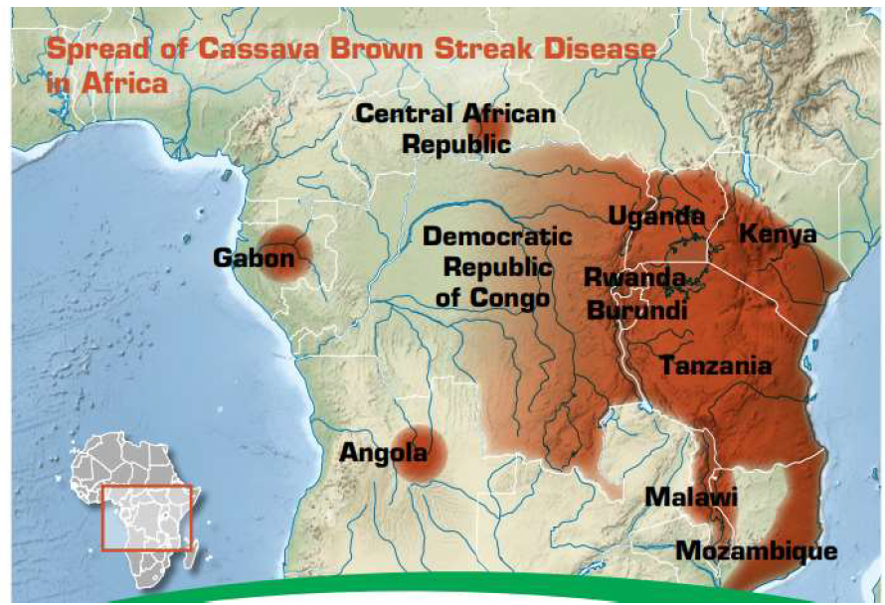
Cassava virus timeline
CMV: Widespread in Africa/India
1900-2000s:
CBSV:
Notes:
Nigeria is the high yielding country in West Africa

Slide 20
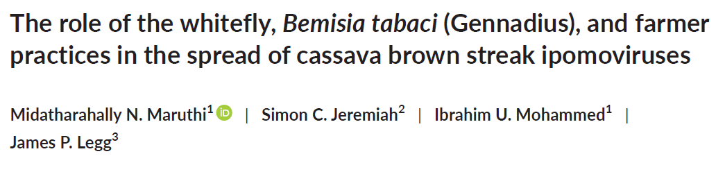
Please read the paper’s title.
Is any jargon unclear?
What will we learn about from this paper?

Slide 21
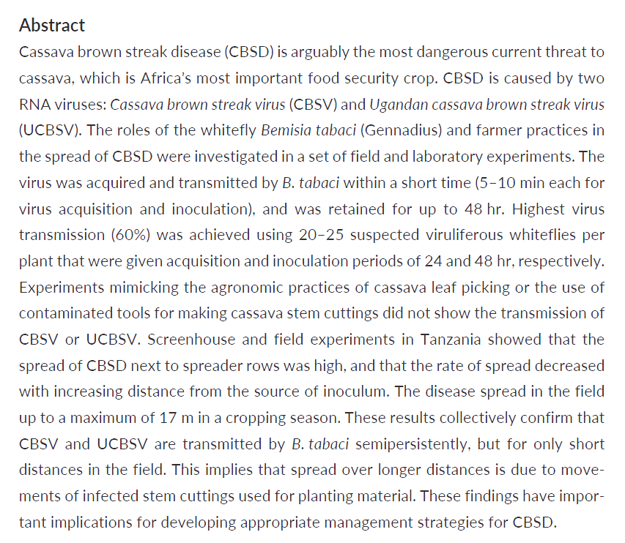
Please read the Abstract.
Is any jargon unclear?
What will we learn about from this paper?

